Slide 1



Course freak
Your academic assistant.

Slide 2


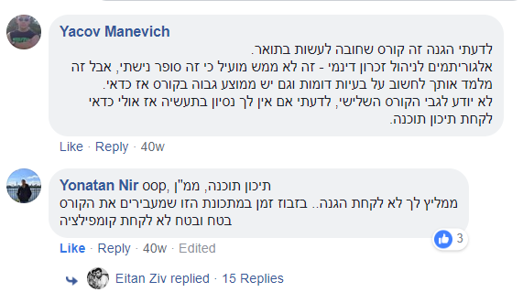
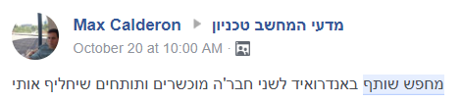
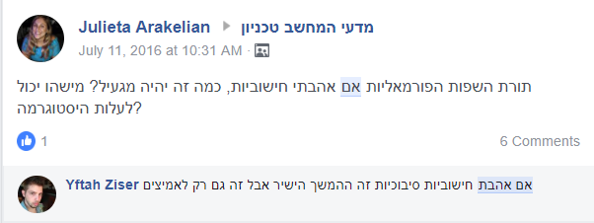

Our problem:
Distributed,
unorganized,
Inaccessible & out-of-date information.

Slide 3



Our Users:
Technion CS students, staff members and guests.
Our Solution:
A unified platform for all
course-related tasks in an interactive environment, just a finger click away.
Improved quality of data achieved by using our ‘HiveMind’ architecture.
Course matching using our ML Recommender engine.

Slide 4

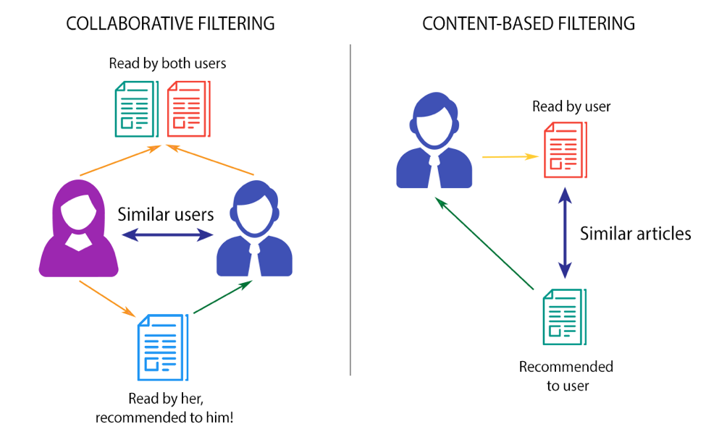
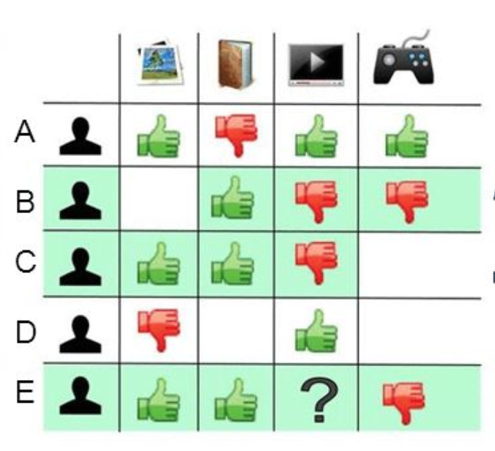

C f
HiveMind
We keep all past years students’ reviews and ratings to use the wisdom of crowds.
We continuously collect up-to-date data and filter it for you by your interests and needs.
We use students’ feedback to show you only top reviews
We use advanced ML algorithms to give you the best recommendations for courses you might like.

Slide 5



Course freak App
Interactive, Android based UI that allows you to :
Be a part of the mind hive
Share your experience with other students.
Write reviews & give feedback to others.
Play our interactive game and win honey jars
while helping us improve our data accuracy.
With us, your opinion really makes a difference.
Always stay alert
Let our smart engine let you know when new opportunities arise.
When your friends are looking for partners or are interested in a course, you’ll be the first to know.
With us, you will never miss a chance.
Time to make decisions?
Let our sophisticated machines
do all the work for you.
Rank a few courses you already took,
sit back and let our app show you your future.
Our background algorithm will find
students with taste like yours.
With us, you will never again take advice from a מצטיין נשיא.
Course freak

Slide 6



Our Team
Roy Hirsch
Amit Sdeor
Denis N
UI & Cloud Infrastructures expert
Big Data & Machine Learning expert
End-to-End Android expert

Slide 7

Questions?

